Slide 1
The Effect of Construction on Local Businesses:
Interim Project Update
Controller's Office
City and County of San Francisco
September 20, 2017

Slide 2
The Question: How Do City Construction Projects Affect Local Businesses?
Using sales tax data on individual businesses, we compared retail sales in six construction zones with retail sales in appropriate benchmark areas.
Our preliminary findings based on these six construction zones is mixed:
Retailers in two construction zones—those with the longest construction period—suffered negative effects during construction. There was no significant effect during construction in the other four zones.
After construction, retailers in two zones remained below their pre-construction level sales. Two other zones showed increased sales for retailers in the years after construction.

Slide 3
The Effect of Construction on Neighborhoods: Two Previous Studies
SFMTA sponsored a study in 2014 that analyzed how construction affected neighborhoods.
The authors compared changes in sales tax revenue in the construction zones to changes in nearby, comparable areas not affected by construction.
The authors found that there was little difference in sales tax revenue between pre-construction and the first year post-construction.
In the second and third years after construction, however, sales tax revenues were about 5% higher than the pre-construction time period.
New York City performed an analysis with the same methodology, and found similar results.
Neither study looked at the effect on businesses during construction.

Slide 4
The Effect of Construction on Sales Tax Revenue from Individual Businesses
The SFMTA and NYC studies looked at total tax revenue in construction zones, but they do not directly measure the effect on individual businesses.
Using neighborhood totals, results are driven by the effects on large retailers.
Effects on individual businesses can be obscured by looking at neighborhood totals. For example, a neighborhood booming after construction could attract new businesses that compete with established ones.
In contrast, we analyze sales tax data at the level of individual businesses, which allows us to estimate specifically how construction affects local businesses on average, regardless of business size.
The Controller's Office's confidentiality agreement with the State Board of Equalization prohibits us from releasing any information that would disclose the amount of tax paid by any particular business.

Slide 5
Limitations of the Analysis
The data used in the analysis is limited to taxable sales. To the extent that taxable and non-taxable sales react differently to construction, our analysis would not account for those differences.
This analysis does not consider the short or long-term impacts if construction had not taken place.
Because the analysis estimates the average effect on individual businesses, it does not capture how the neighborhood as a whole may grow or decline from new businesses entering the neighborhood or established businesses leaving.
Further out in the post-construction period, the results are increasingly likely to be affected by factors other than construction.

Slide 6
Characteristics of the Six Construction Zones Included in the Analysis
To be included in our analysis, a construction zone must be a well-defined geographic area with accurate start and end dates. It must also be large enough to give reliable statistical conclusions.
We have so far identified these six construction zones:

Slide 7
The Methodology: Choosing a Benchmark
We use a regression analysis to estimate how businesses in the construction zone fared on average during and after construction relative to the three year period prior to construction.
For each construction zone, we select an area not affected by construction that serves as the "benchmark" for how businesses in the construction zone would have performed but for the construction.
Our work so far has used three different benchmarks: (1) the zip code where the construction was located; (2) the zip code and all adjacent zip codes; and (3) all of San Francisco.
In the six construction zones, the chosen benchmark made little difference in the estimated effect of construction. The results that follow come only from benchmark (1).
We also control for industry and time period, so the comparison between the construction zone and the benchmark reflects differences in the distribution of industries over time.

Slide 8
The Average Change in Sales Tax Revenue During Construction
Note: Dashes indicate the estimated average change was not statistically significant.

Slide 9
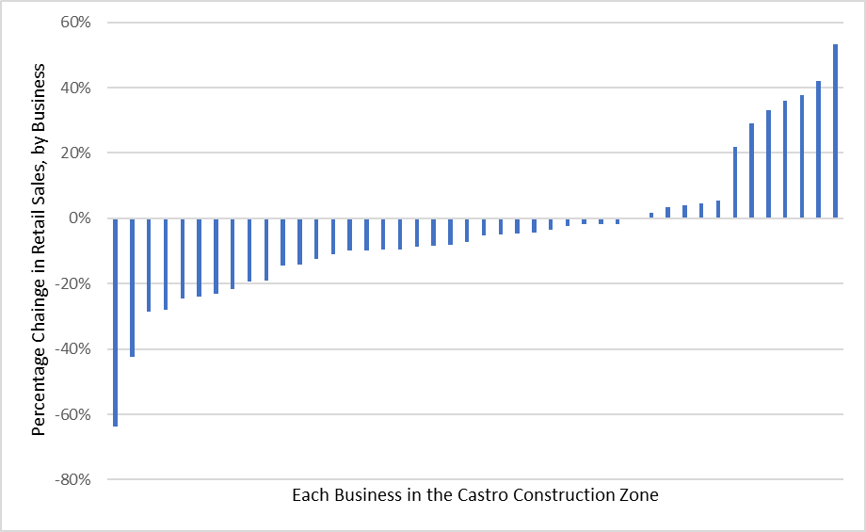
Change in Taxable Sales for Castro Street Businesses One Year Prior to Construction to the First Full Quarter of Construction

Slide 10
The Average Change in Sales Tax after Construction
Note: Dashes indicate the estimated average change was not statistically significant. The later years for Castro and West Portal are not estimated because the end dates for construction are 2014 and 2016, respectively.

Slide 11
Interim Findings and Next Steps
Our review thus far shows the effect construction has on local businesses varies by project. Retailers were negatively impacted in the two construction zones with the longest project duration. Post-construction, two zones remained below their pre-construction level, and two had increased sales in the years after construction.
We continue to look at additional construction zones. In particular, we are researching T-Third construction as it may be the project most comparable to the Central Subway project.
We will present final results to the Board as our analysis is completed.

